Slide 1
Backtracking Line Search with Armijo-Goldstein Condition
Ali Janloo
Ali Alavizadeh
Amir Ali Akhgari

Slide 2
Armijo-Goldstein Condition & Backtracking Line Search
The Armijo-Goldstein condition is a criterion used in optimization algorithms to determine the step size along a given direction during line search. It ensures that the step size satisfies both a sufficient decrease condition and a curvature condition, balancing between making sufficient progress and avoiding excessive steps.

Slide 3
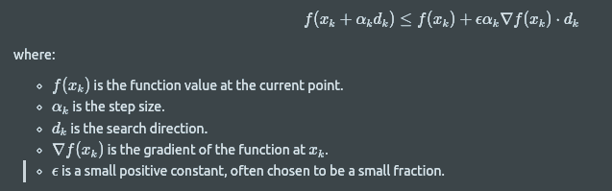
Armijo-Goldstein Condition
Sufficient Decrease Condition (Armijo Condition): It ensures that the function value decreases sufficiently with the step size. Mathematically, it is expressed as:

Slide 4
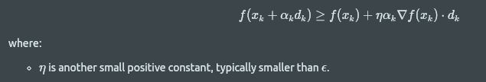
Armijo-Goldstein Condition
Curvature Condition (Goldstein Condition): It ensures that the step size is not too large, preventing excessive progress. Mathematically, it is expressed as:
The Armijo-Goldstein condition requires that the step size ɑ_k satisfies both the Armijo condition and the curvature condition.

Slide 5
Backtracking Line Search
Backtracking line search is an optimization technique used to find an appropriate step size that satisfies the Armijo-Goldstein condition. It iteratively reduces the step size until the condition is met.

Slide 6
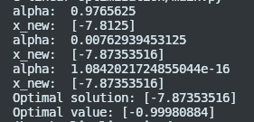
Example
Consider function sin(x) as example.
We have cos(x) as derivative function.
x0 = 0 as initial point
d = -8 as direction
Initial_alpha = 1000 as the starting alpha in the backtracking_line_search

Slide 7
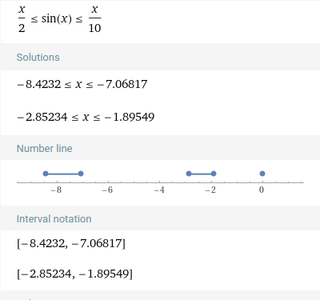
Why we choose d = -8 ?
If we select an incorrect value for 'd', it could cause the alpha in the first step to approach zero, preventing the update of the initial value, x0 = 0. To ensure that x0 is updated, we solve an inequality (Armijo-Goldstien condition) with alpha=1. This value is chosen specifically to guarantee the update of x0 and provides a boundary for selecting an appropriate 'd'.

Slide 8
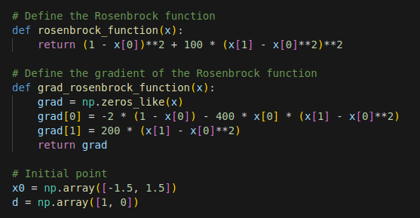
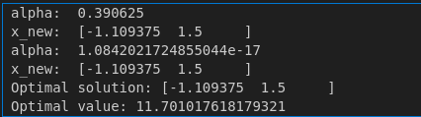
Rosenbrock function (multivariate function)

